Slide 1
The role of magnetic fields in the acceleration and radiation of blazars
Dimitrios Giannios
Purdue, Department of Physics and Astronomy
Beyond a PeV
I.A.P., Paris, September, 14 2016

Slide 2
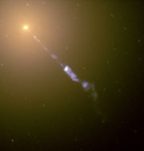
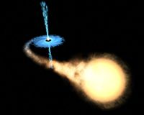
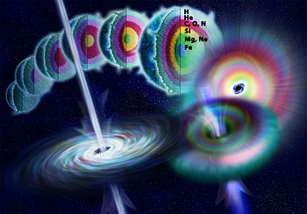
gamma-ray bursts
Relativistic jets from black holes are ubiquitous
jets in galactic centers
X-ray binaries
M87; NASA/Hubble
M_{BH}~10⁹M
~10M
~3M
Power~10⁴⁴...10⁴⁹erg/s ~10³⁸erg/s ~10⁵²erg/s
Notes:
Collimated outflows of matter moving at relativistic speeds “relativistic jets” have been observed/inferred in various astrophysical settings:
Jets originate from the active supermassive black holes at the centers of galaxies, stellar binaries that contain a compact object
and in gamma-ray bursts.
All these sources contain compact objects (BHs or neutron stars)
SMBHs ~billions of Msun actively fed material from the region around the nucleus of the galaxy form jets
Micro-quasars are binary systems of stars were a bh of ~10Msun is fed matter by the companion.
Gamma-ray bursts are extremely bright and short lived explosions of gamma-rays.
They can be observed at large distances (cosmological redshift of at least z=8).
Come from core collapse of massive stars marking the birth a few solar mass compact object.

Slide 3
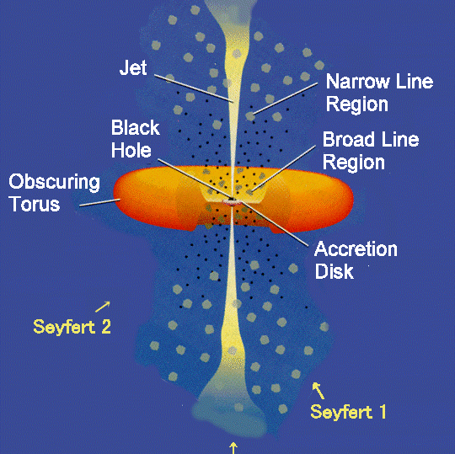
Blazars:
Jets in AGN moving towards us
Blazar

Slide 4
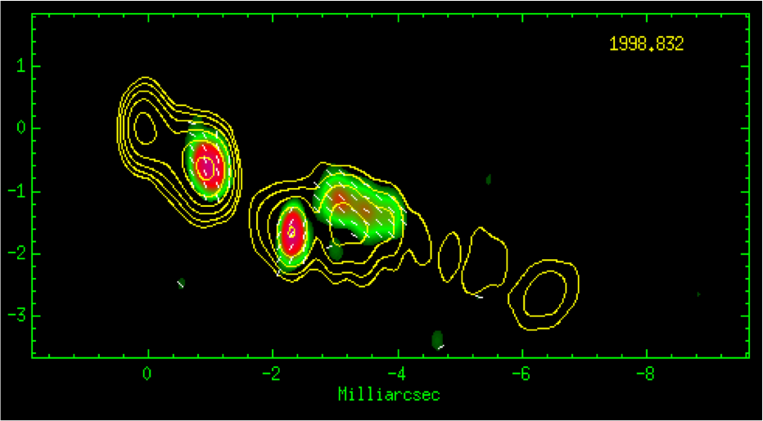
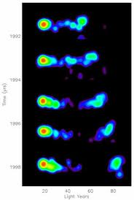
Jet speed inferred from “superluminal” motions
Biretta, Moore, Cohen 1986 Wehrle et al. 2001
3C120; VLBA; Gomez et al. 2008
time
3C279
Rees 1966
Γ~10 in blazars
Distance
Notes:
But how fast are these jets? What is the bulk Lorentz factor of the flow, Gamma?
Direct observations in the radio resolve fast (superluminal) motions of gas in galactic centers.
Apparent speeds of blobs larger than the speed of light have commonly been measured (show right plot and explain).
These apparent motions are result of matter moving fast close (but not exactly)
along our line of sight. The apparent speeds set a lower limit on the Lorentz factor.
The bulk Lorentz factor of AGN jets is typically ~10
GRBs are not resolved to allow for direct measurement of their LF.
Strong theoretical arguments, however, related to the fact that the gamma-rays avoid annihilation at the source
place the Lorentz factor of the radiating material to 100-1000
jets in binary systems have more modest LFs of a few-10.

Slide 5
Blazars: bright at all frequencies
erg/s
e.g., Fossati et al. 1998
Notes:
Systematic study of the electromagnetic radiation from blazars has been done for decades from radio wavelengths (~10^9 Hz) to TeV gamma-rays (10^26 Hz).
A collection of spectra is shown here in a nu*L_nu versus frequency plot (peaks in such plot show the frequency at which
most of the energy comes out).
Blazars have a characteristic Double Bump Spectrum. The first bump appears at Infra red to X-rays (10^13-10^16 Hz) and the second at the gamma rays
(>10^21 Hz). The low-frequency bump is result of very energetic electrons gyrating magnetic field lines (synchrotron emission).
The same electrons can upscatter low-energy photons into the gamma-rays (inverse Compton scattering)
giving the high-frequency bump.
The dissipative mechanism that accelerates the electrons is unknown/uncertain!
Blazars are variable on timescales from several hours to years. Their variability is understood as coming from variations
of the properties of gas at the launching region of the jet.
It is a fast evolving field observationally! State of the art and coming missions revolutionalise our knowledge and bring new mysteries
about jets. Recently extremely fast flares where observed in blazars that were completely unexpected! Nustar can make a major contribution
is the timing domain in hard X-rays.

Slide 6
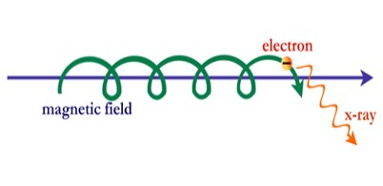
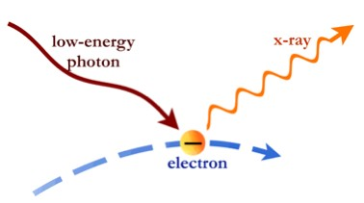
Blazars: bright at all frequencies
erg/s
synchrotron
inverse Compton scattering
e.g., Fossati et al. 1998
Notes:
Systematic study of the electromagnetic radiation from blazars has been done for decades from radio wavelengths (~10^9 Hz) to TeV gamma-rays (10^26 Hz).
A collection of spectra is shown here in a nu*L_nu versus frequency plot (peaks in such plot show the frequency at which
most of the energy comes out).
Blazars have a characteristic Double Bump Spectrum. The first bump appears at Infra red to X-rays (10^13-10^16 Hz) and the second at the gamma rays
(>10^21 Hz). The low-frequency bump is result of very energetic electrons gyrating magnetic field lines (synchrotron emission).
The same electrons can upscatter low-energy photons into the gamma-rays (inverse Compton scattering)
giving the high-frequency bump.
The dissipative mechanism that accelerates the electrons is unknown/uncertain!
Blazars are variable on timescales from several hours to years. Their variability is understood as coming from variations
of the properties of gas at the launching region of the jet.
It is a fast evolving field observationally! State of the art and coming missions revolutionalise our knowledge and bring new mysteries
about jets. Recently extremely fast flares where observed in blazars that were completely unexpected! Nustar can make a major contribution
is the timing domain in hard X-rays.

Slide 7
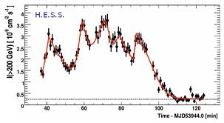
Blazars flaring from days down to ~5 minutes!
3C279; e.g., Collmar et al. 2007
10 days
10 min
10 min
Aharonian et al. 2007; Albert et al. 2007; Aleksic et al. 2011

Slide 8

Source of blazar flares:
“Blobs” of energetic e⁻ and B fields
R_{em}
θ~1/Γ_{em}
Γ_{em}
Doppler factor δ=[Γ_{em}(1-β_{em}cosθ)]⁻¹ ~Γ_{em}

Slide 9
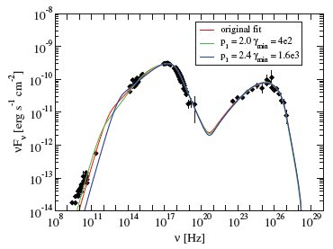
Basic Observed/inferred properties of blazars
SSC model fit of the spectral energy distribution of Mrk 421
Effective particle accelerators up to multi TeV energies, at least
Efficient radiators ~10% radiative efficiency or more!
Radiating particles and magnetic field in, very rough, equipartition:
Extreme variability variable t_{var}<<R_{g}/c in some cases!
Notes:
But how fast are these jets? What is the bulk Lorentz factor of the flow, Gamma?
Direct observations in the radio resolve fast (superluminal) motions of gas in galactic centers.
Apparent speeds of blobs larger than the speed of light have commonly been measured (show right plot and explain).
These apparent motions are result of matter moving fast close (but not exactly)
along our line of sight. The apparent speeds set a lower limit on the Lorentz factor.
The bulk Lorentz factor of AGN jets is typically ~10
GRBs are not resolved to allow for direct measurement of their LF.
Strong theoretical arguments, however, related to the fact that the gamma-rays avoid annihilation at the source
place the Lorentz factor of the radiating material to 100-1000
jets in binary systems have more modest LFs of a few-10.

Slide 10
Stringent requirements for emitting region
Emitter must be very compact and extremely fast and form at ~1 pc distance!
R_{em}~10⁻⁴ pc!
R_{diss}~1 pc
Γ_{em}~50
Γ_{j}~10
Some big questions:
Which process accelerates the particles that radiate?
What determines the distance & size/shape of the
emitting region?

Slide 11
Blazars as UHECR accelerators
“Hillas” Diagram

Slide 12
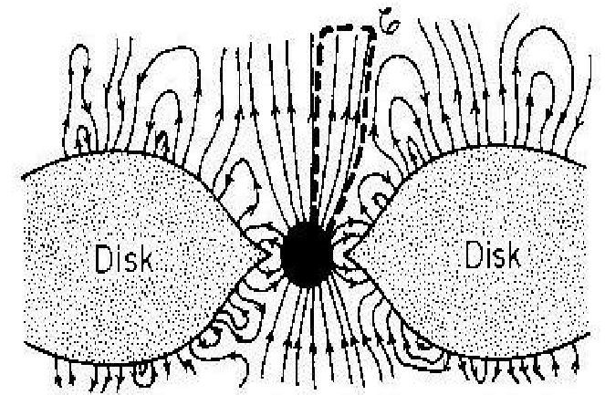
My view of jets
magnetic reconnection region
“blazar” zone
acceleration
launching
Blandford & Znajek 1977
Begelman & Li 1992
Meier et al. 2001
Koide et al. 2001
Komissarov, Lyubarky,
McKinney, Tchekhovskoy…
Notes:
While my main focus in this talk will be on the radiation from jets. I argue that it cannot be understood independently of the
properties of the CE and the acceleration process of the jet.

Slide 13
Magnetic fields can launch
B-dominated jets from black holes
Blandford & Znajek 1977

Slide 14
Origin of magnetic fields:
carried in from large scales?

Slide 15
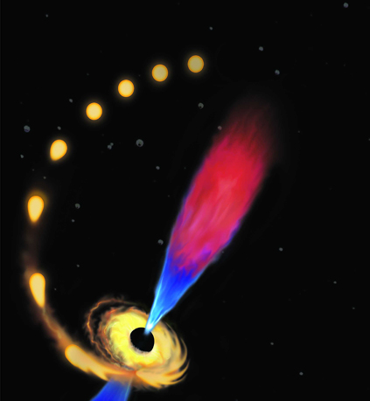
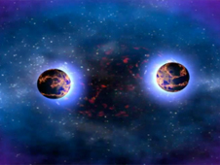
Magnetic fields at progenitor are not always sufficient
binary neutron star mergers:
Short GRBs
Stellar Tidal Disruption Jets (J1644) Giannios & Metzger 2011; Bloom et al. 2011

Slide 16
Origin of magnetic fields: generated locally by the disk?
Step II
Inner part of the loop advected to the black hole
Step III
Differential rotation inflates loop
field lines open
→ jet forms
Step I
magnetic loop emerging from the disk
loop scale ~disk scale hight
Parfrey, Giannios, Beloborodov 2015

Slide 17
General Relativistic MHD simulations
Parfrey, Giannios, Beloborodov 2015
V_{accrete}

Slide 18
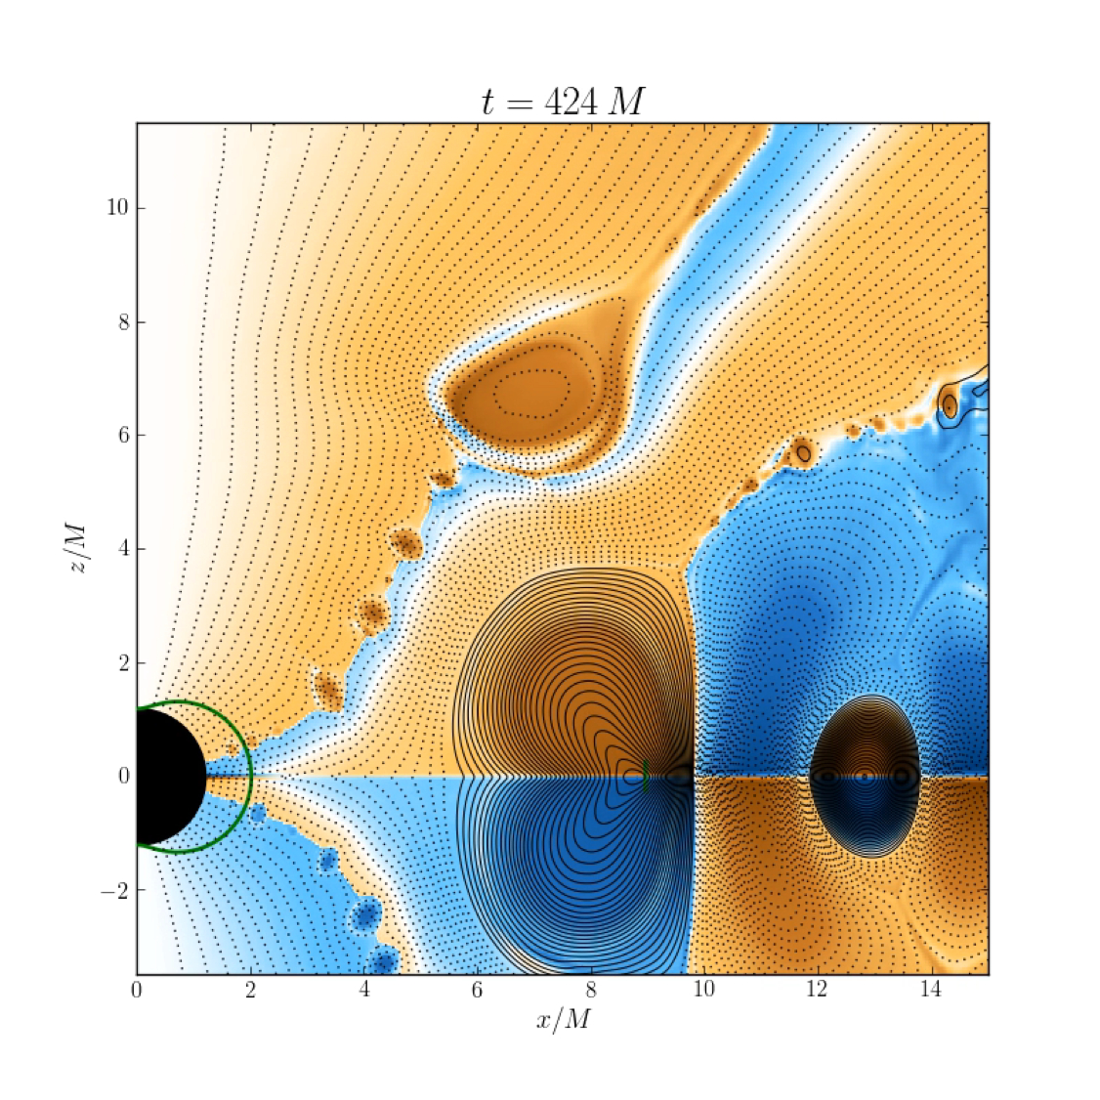


Parfrey, Giannios, Beloborodov 2015
Retrograde disc
loop width = 2 rg
loop direction
clockwise
anti-clockwise
Colour: Hϕ
positive
negative

Slide 19
The jet power

Slide 20

A powerful jet
Parfrey, Giannios, Beloborodov 2015
For retrograde orbits r_{isco}/r_{g}~10 and thick
H/r~1 disks the jet power reaches

Slide 21

Part II:
jet dissipation and radiation

Slide 22
Part II:
jet dissipation and radiation
magnetic reconnection region
dissipation/radiation region
acceleration
launching

Slide 23
Large-scale jet and emission
~hundreds R_{g}

Slide 24
Magnetic reconnection in the jet
Jet may contain field reversals on small scale ~100 R_{g}
magnetic-reconnection becomes effective when t_{exp}~t_{rec} where v_{rec}=εc
~100R_{g}

Slide 25
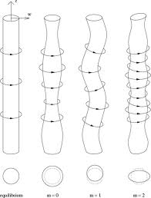
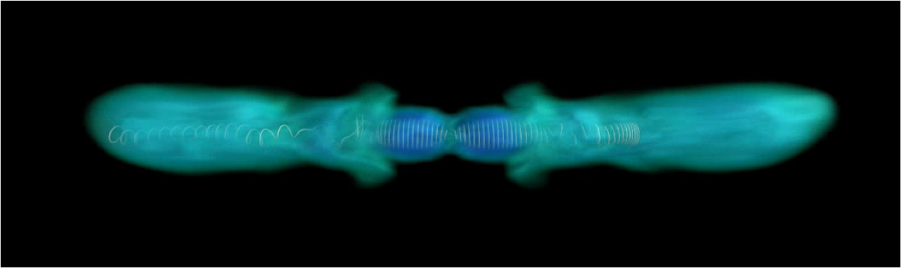
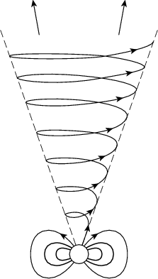
Magnetic reconnection due to
MHD instabilities in jets
Magnetized jets may be prone to the kink instability
Eichler 1993; Begelman 1998; Nakamura & Meier 2004; Giannios & Spruit 2006; Moll 2009; McKinney & Blandford 2009; Mignone et al. 2010; Porth & Komissarov 2015
r
r
r
Barniol-Duran, Tchekhovskoy & Giannios 2016, in prep.
kink instability
Notes:
How to get such small scale field that is prone to magnetic reconnection?
The first possibility is MHD instabilities develop on the outflows.
The instabilities can introduce small scales in the field in the jet
that are prone to reconnection.
Because of a combination of expansion and rotation, the jet develops a strong toroidal
field component. This tightly wound helix it is prone to instabilities
similar to ones developing to tokamak experiments (show left plot).
The m=1 kink instability is particularly relevant for jets. I have contributed to its
study with analytical modeling of its effects to the jet structure.
Since it is a non-axisymmetric instability (show left figure), its study requires 3D relativistic MHD simulations. This becomes a
possible problem to attack! Recent Newtonian simulations by R. Moll have demonstrated the development of the instability and extensive (numerical) dissipation
of magnetic energy (explain right figure). It remains to be seen if relativistic jets suffer from kinks.

Slide 26
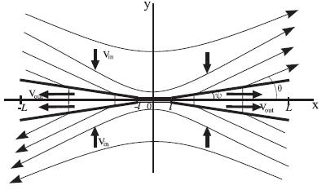
A promising dissipative mechanism:
Magnetic Reconnection
blazar zone
B
An efficient convertor of magnetic energy into bulk motion, heat, energetic particles
  cold, magnetized plasma enters the reconnection region
  plasma leaves the reconnection region at the Alfvén speed Γ_{out}~(1+σ)^{1/2}>1
  reconnected material contains energetic (nonthermal) particles
B

Slide 27
Reconnection Plasmoids = blazar blobs?
Current sheet fragments to plasmoids Loureiro et al. 2007; Uzdensky et al. 2010; Loureiro et al. 2012+++
Plasmoids merge/grow leaving the layer at V_{A}~c
The largest plasmoids can power bright/ultrafast blazar flares Giannios 2013
Giannios et al. 2009; 2010; Giannios 2013

Slide 28
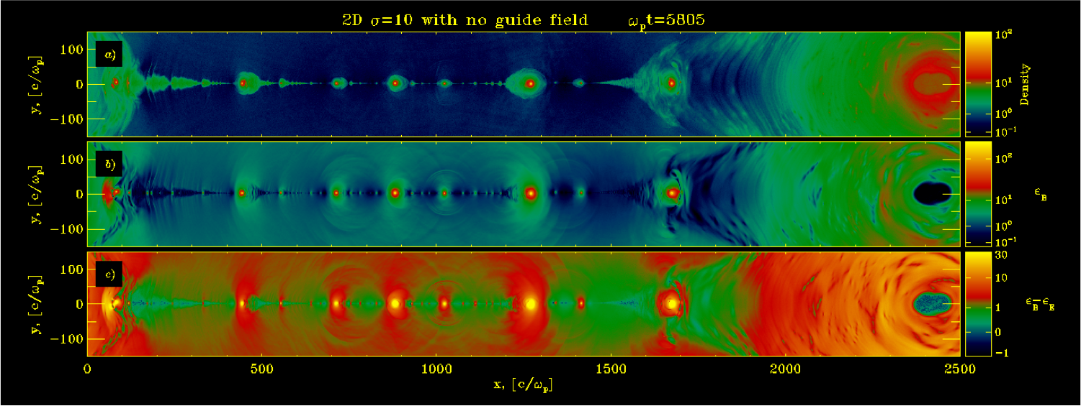
Magnetic reconnection from first-principle simulations
Sironi & Spitkovsky 2014; Sironi, Petropoulou & Giannios 2015;
Sironi, Giannios & Petropoulou 2016

Slide 29
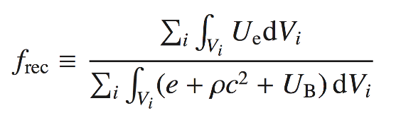
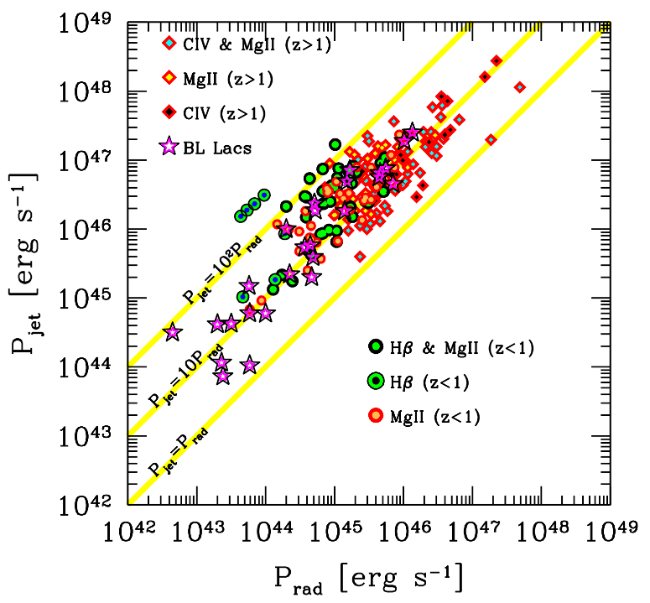
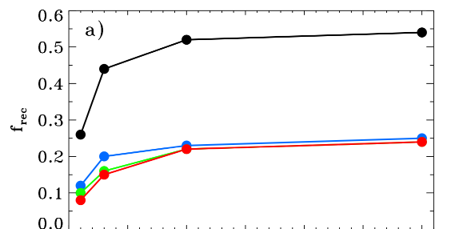

(1) Relativistic reconnection is efficient
electron-positron
electron-proton
(Sironi, Petropoulou, Giannios 15)
Relativistic reconnection:
it transfers ~ 50% of the flow energy (electron-positron plasmas) or ~ 25% (electron-proton) to the emitting particles
Ghisellini et al. 2014
Blazar phenomenology:
blazars are efficient emitters (radiated power ~ 10% of jet power)

Slide 30
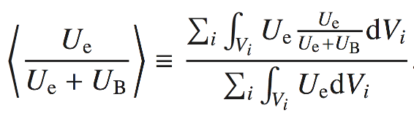
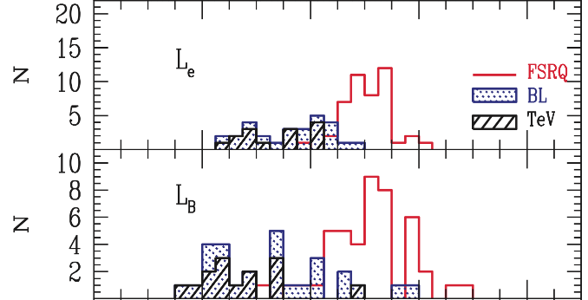
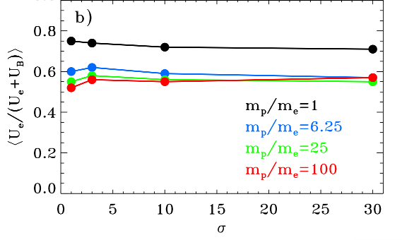

(2) Equipartition of particles and fields
electron energy
electron-positron
magnetic energy
electron-proton
(Celotti+ 08)
(Sironi, Petropoulou & Giannios 2015)
Relativistic reconnection:
in the magnetic islands, it naturally results in rough energy equipartition between particles and magnetic field
Blazar phenomenology:
rough energy equipartition between emitting particles and magnetic field

Slide 31
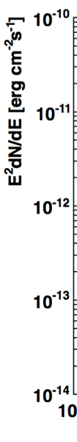
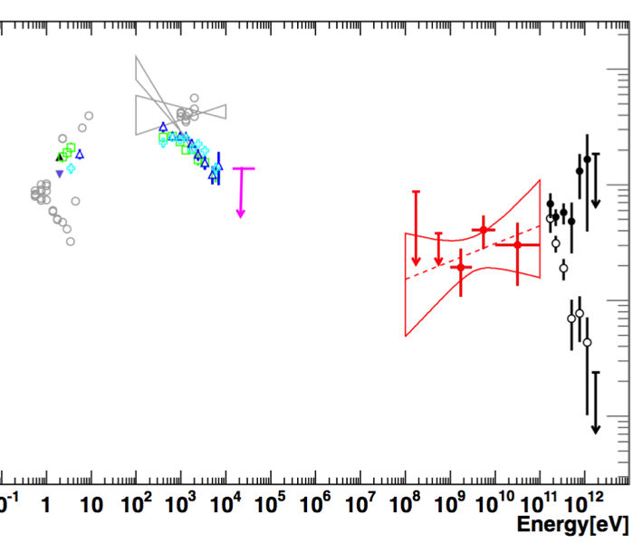
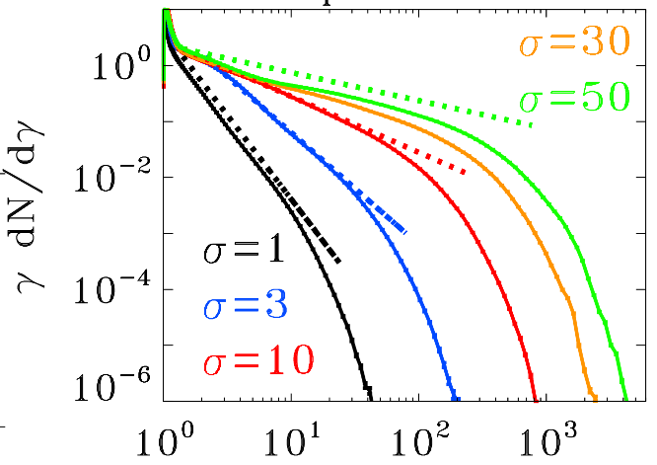
(3) Extended non-thermal distributions
p=1.5
hard GeV-TeV spectra
p=2
p=3
p=4
(HESS 11)
γ
Blazar phenomenology:
extended power-law distributions of the emitting particles, with hard slope
(Sironi & Spitkovsky 14, Guo et al. 14, Werner et al. 14)
Relativistic reconnection:
it produces extended non-thermal tails of accelerated particles, whose power-law slope can be harder than p=2

Slide 32
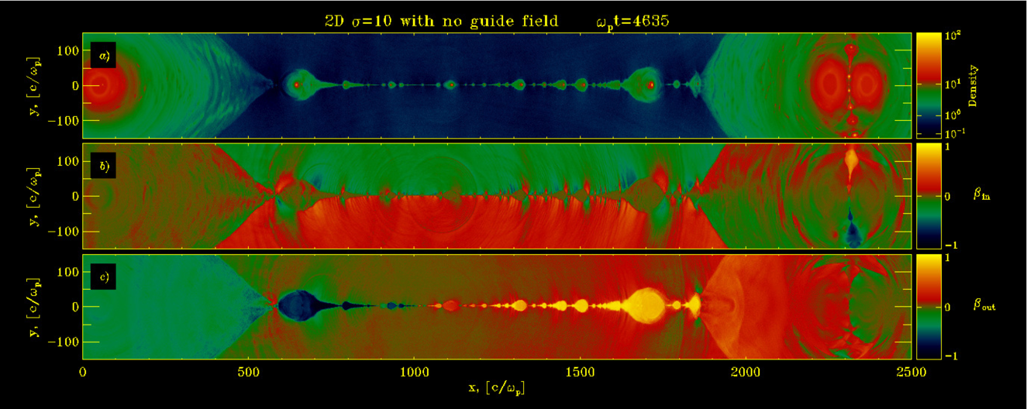
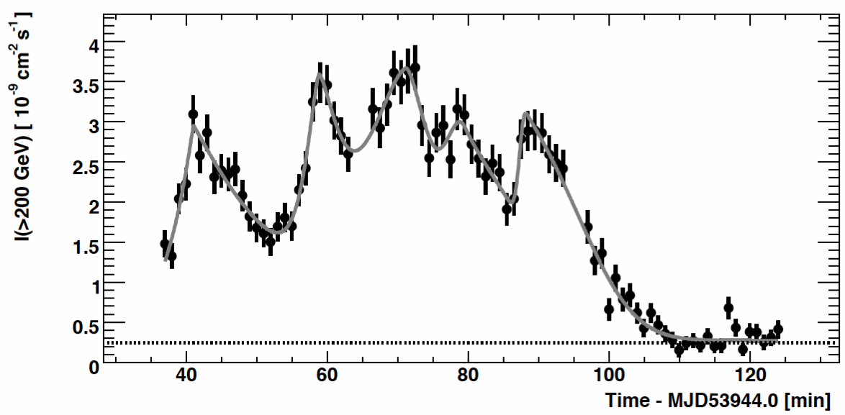
(4) Extreme temporal variability
Density
Inflow speed
Outflow speed
(Coppi & Aharonian 99, Boettcher 07)
(Aharonian et al. 07)
Giannios 2013
10 mins
Relativistic reconnection:
large/fast islands might be a promising source of fast variability
Blazar phenomenology:
at TeV energies, fast (~10 minutes) flares on a high-state envelope lasting for ~days
t_{envelope}~1 day

Slide 33
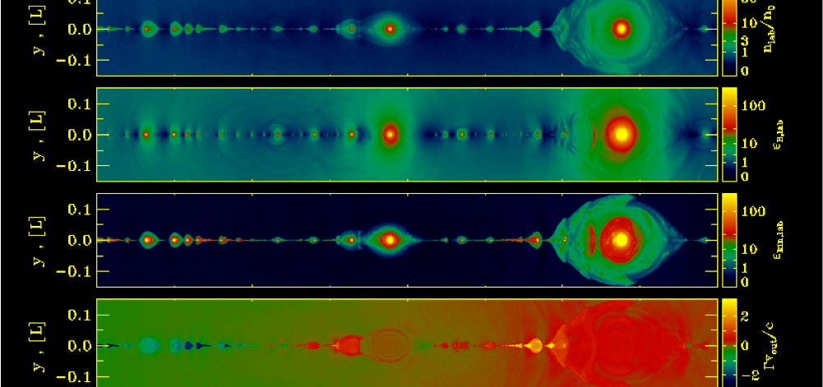
From first principle simulations to lightcurves
Sironi, Giannios & Petropoulou 2016
Credit: Sironi

Slide 34
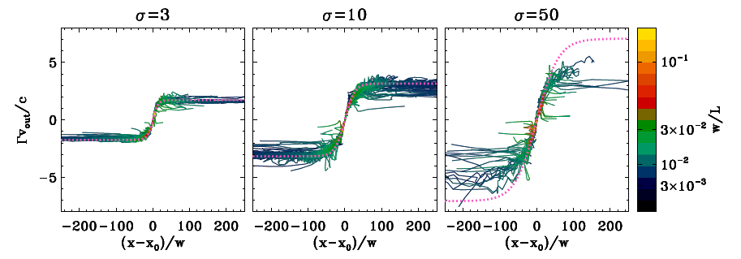
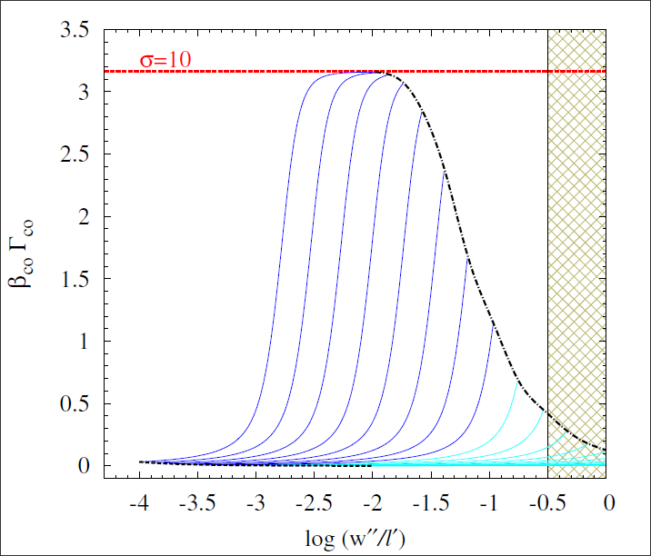
Plasmoid momentum: an example
Exit (final)
Very rare
Blue:small & relativistic
Cyan: large & non-relativistic

Slide 35
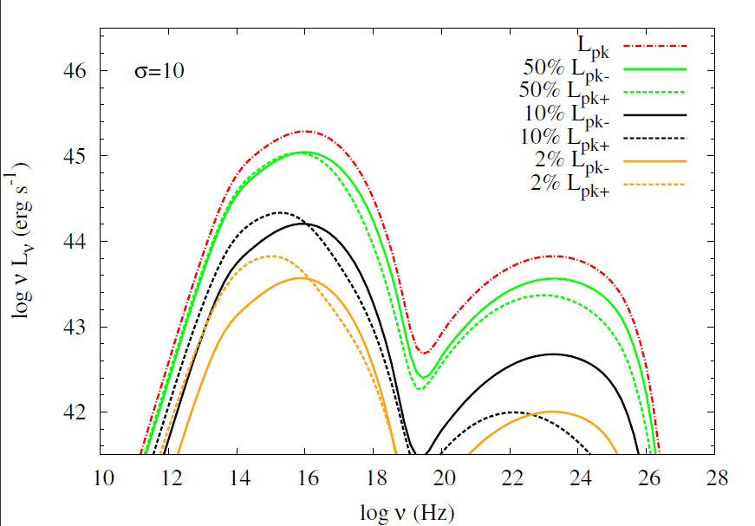
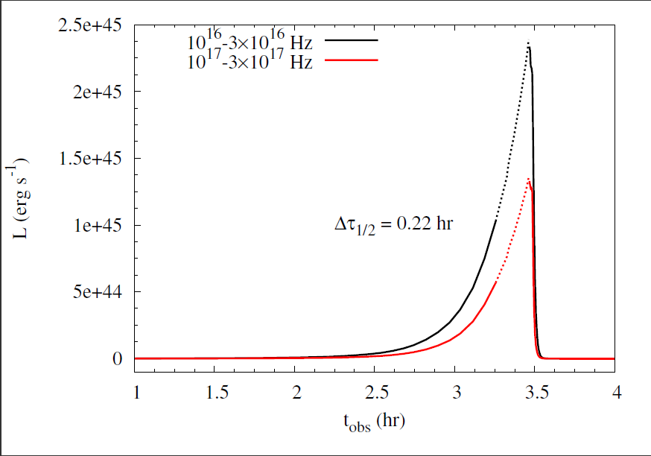
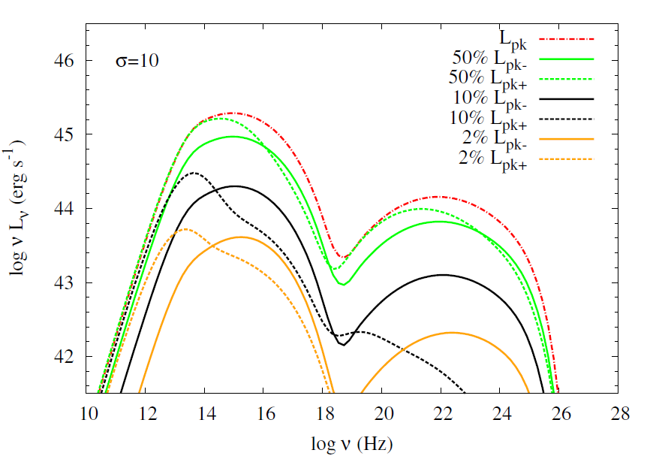
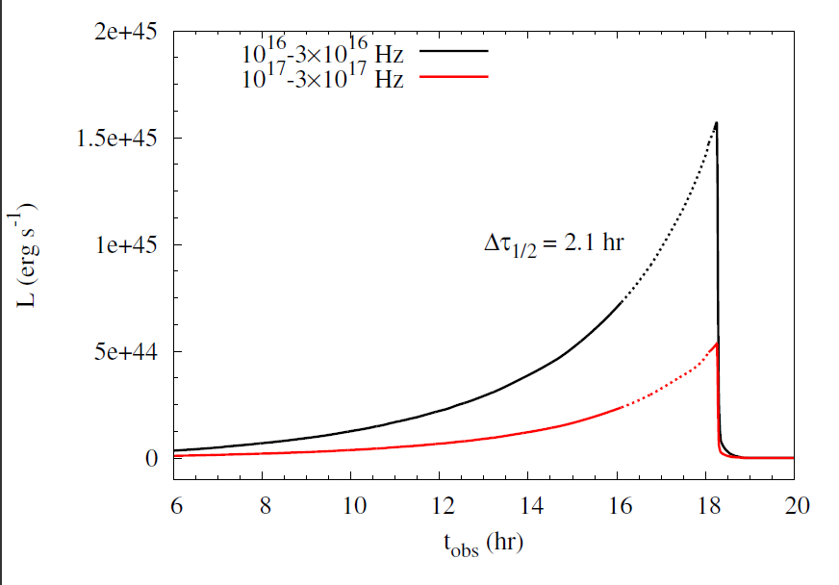
From PIC simulations to lightcurves
Petropoulou, Giannios & Sironi 2016
Small & Fast Plasmoid
Large & Slow plasmoid

Slide 36
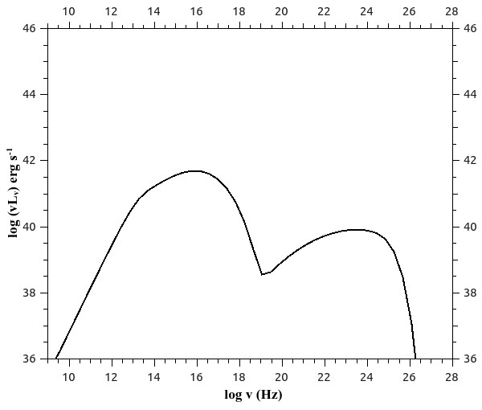
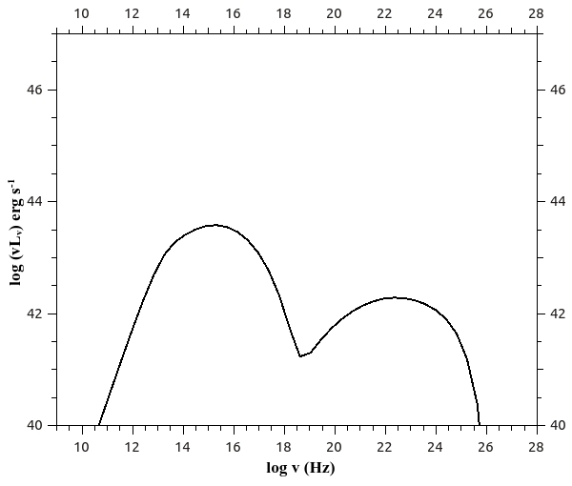
From first principle simulations to lightcurves
Petropoulou, Giannios & Sironi 2016
Small & Fast Plasmoid
Large & Slow plasmoid

Slide 37
Work in progress
complete lightcurve from a layer: emission from all plasmoids in the current sheet
the “afterglow” emission: radio flares after a gamma-ray flare?
connect to the large-scale jet:
  where the reconnection takes place?
  how large are the reconnection regions?

Slide 38
Concluding
Are large-scale fields required to make Jets?
  Disk-generated fields may launch powerful jets
2) Jets are observed to be efficient particle accelerators, highly variable
  Magnetic reconnection can produce both
Blazar “blobs” = reconnection plasmoids ?

Slide 39
Blazars as UHECR accelerators
The most energetic particles have gyration radius a large fraction (~20%) of the size of the blob
Protons can reach ~10¹⁹ eV or more in powerful flares
“Hillas” Diagram

